Slide 1
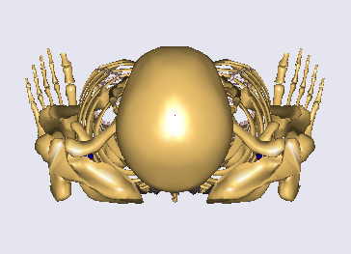
Results – Joint reaction forces
TR 0 °
Fx [N]
-40D
40D
Fy [N]
Fy
Fx
Fz
Fz [N]
Sagittal rotation

Slide 2
Results – Joint reaction forces
TR 30 °
Fx [N]
-40D
40D
Fy [N]
Fz [N]
Sagittal rotation

Slide 3
Results – Joint reaction forces
TR 60 °
Fx [N]
-40D
40D
Fy [N]
Fz [N]
Sagittal rotation

Slide 4
Results – Joint reaction forces
TR 90 °
Fx [N]
-40D
Fy [N]
40D
Fz [N]
Sagittal rotation

Slide 5
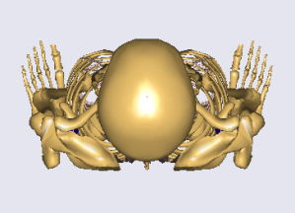
Results – Muscle forces
-40D
40D
Left side
Right side
Sagittal rotation
Sagittal rotation

Slide 6
Results – Muscle forces
-40D
40D
Left side
Right side
Sagittal rotation
Sagittal rotation

Slide 7
Results – Muscle forces
-40D
40D
Left side
Right side
Sagittal rotation
Sagittal rotation

Slide 8
Results – Muscle forces
-40D
40D
Left side
Right side
Sagittal rotation
Sagittal rotation

Slide 9
Discussion
As the transverse rotation of the body increased, A-P shear decreased with an increase of lateral shear during sagittal rotation.
Muscle activation was concentrated on certain muscles such as longissimus, iliocostalis, Psoas Major when the body was right in the center (TR roation 0°) but several muscles started to involve to balance the body as the transverse rotation increased while either of sagittal rotation angle changes.
Rectus abdominis decreased considerably as the transverse rotation angle increased.
In general, combined rotations of the body induced increase of shear forces and more recruitment of muscles to keep the posture, concurrently.
The considerable exercise effect in the muscles were observed via the 3-D Newton device.

