Slide 1
Evaluation of exercise effect of 3-D Newton and Centaur
2012.09.21

Slide 2
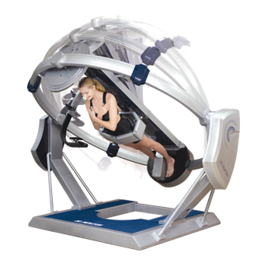
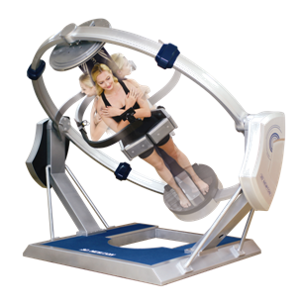
Methods
Exercise using 3D Newton
1-기울기 10도,20도, 30도, 40도, 회전360도에서의 신체 근육의 부하량 요소 계산

Slide 3
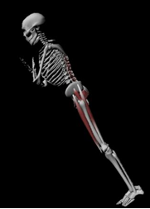
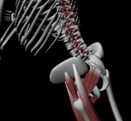
Methods
Exercise using 3D Newton
1-기울기 10도,20도, 30도, 40도 신체 근육의 부하량 요소 계산

Slide 4
Methods
AnyBody Model
Front view
Side view

Slide 5
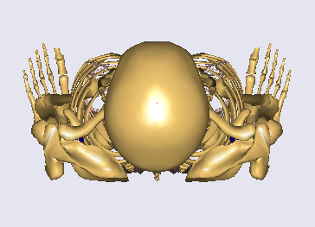
Method
0 °
0 °
30 °
- 20 °
20 °
40 °
- 40 °
60 °
90 °
Transverse rotation (TR) 90D
Sagittal rotation -40D to 40D

Slide 6
Method
Fy
Fx
Components of joint reaction force
Fz is a component normal to xy plane.
Combination of Min/Max and Quadratic muscle recruitment criterion were used to simulate joint and muscle forces

